Slide 1
Project title
Submitted in the partial fulfillment for the award of the degree of
BACHELOR OF ENGINEERING
IN
NAME_OF_SPECIALIZED_BRANCH
Submitted by:
PARMINDER SINGH
19BCS3757
Under the Supervision of:
KUNDAN MUNJAL
Department of AIT-CSE
DISCOVER . LEARN . EMPOWER

Slide 2
Outline
Introduction to Project
Data of project
Objectives of the work
Methodology used
Results and Outputs
Conclusion
Future Scope
References

Slide 3
Introduction
The world Health Organization (WHO) reported 1.35 million deaths each year as result of traffic crashes. The digits mentioned are growing rapidly over past few years. To avoid such tremendous and fatal accidents we propose a deep learning and machine learning based solution to achieve a very high rate of success in avoiding such reckless accidents
Our project has 2 modules: a) driver action detection , b)traffic sign detection

Slide 4
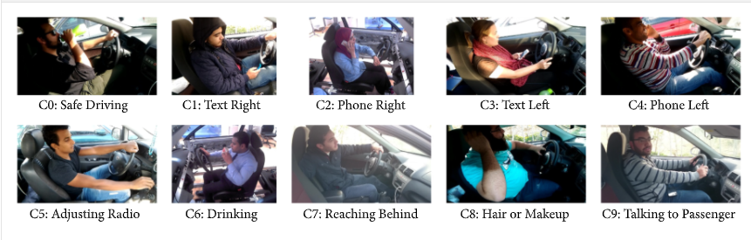
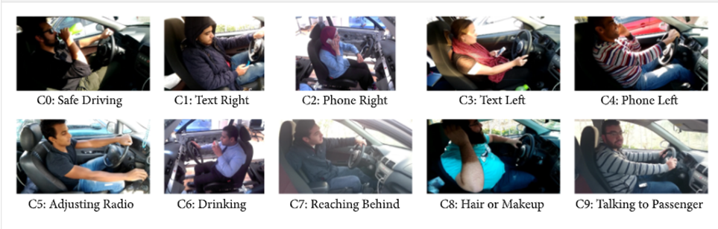
DRIVER ACTION DETECTION
Forming VGG-16 based CNN model for image classification on both driver action dataset and on traffic sign too.
There are multiple things which can distract the driver leading to decrement of concentration on road and on driving
Reaching behind
Eating
Using mobile
Operating radio
Etc.

Slide 5
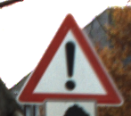
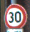
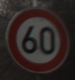

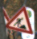
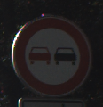

TRAFFIC SIGN DETECTION
Forming another VGG-16 based CNN model for image classification on sample traffic sign dataset .
There are many traffic signs on road side and when a driver is distracted, it is difficult to observe the roadsigns. There are many type of traffic signs like:
Speed limit
Keep left
Stop
School Ahead
Etc.

Slide 6
Objectives
To make roads easier to travel with less percentage of accident happenings
Recognize unsafe behavior
Send real time feedback to the driver using short sound alert

Slide 7
Methodology
A Basic VGG-16 type CNN Model with 3 convolutional layer differentiated by dense layer and all layer is of relu activation function and in end using softmax activation function as there are multiple labels classification
The training of driver dataset is done with adam optimizer for the model to learn with maximum rate with respect to any other optimizers

Slide 8
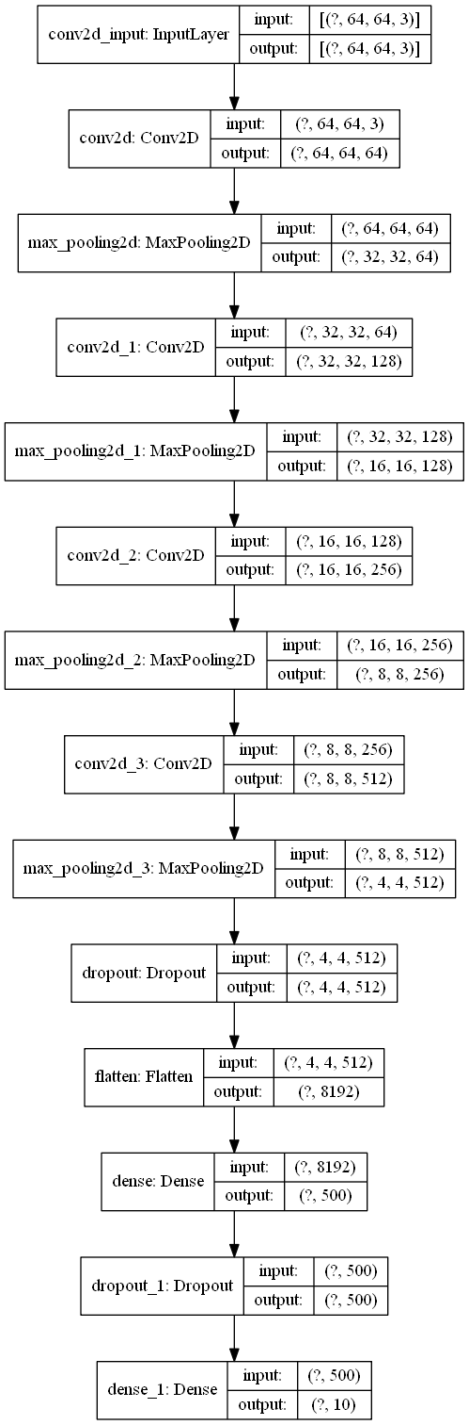
FLOWCHART DRIVER ACTION MODEL

Slide 9
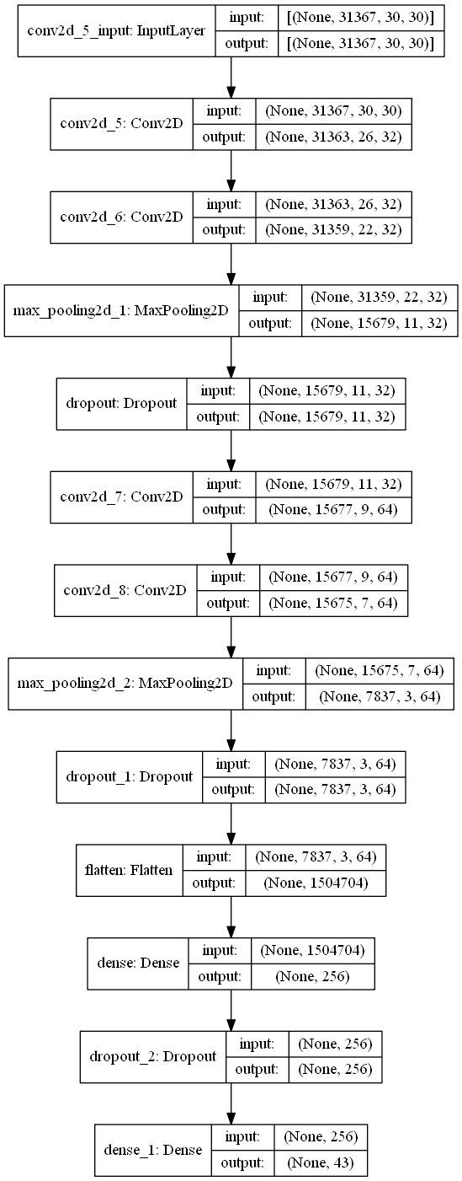
FLOWCHART TRAFFIC SIGN MODEL

Slide 10
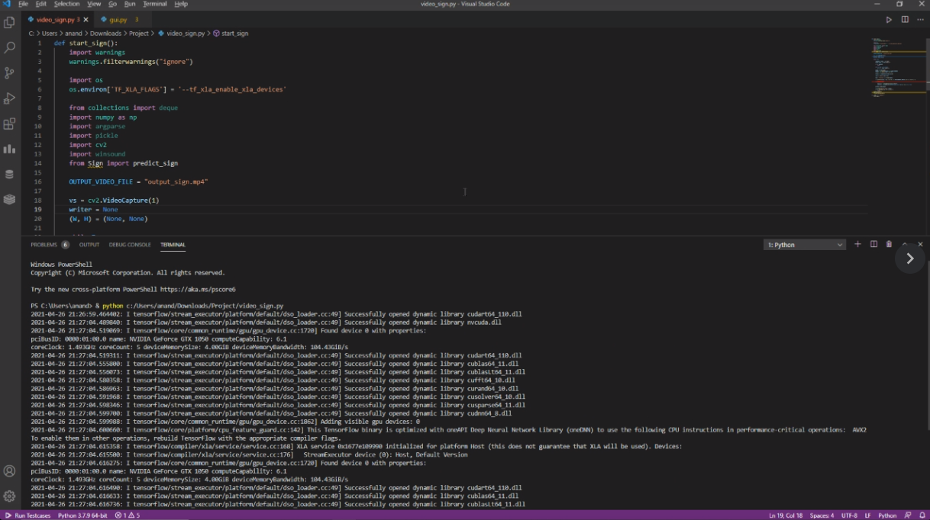
Results and Outputs

Slide 11
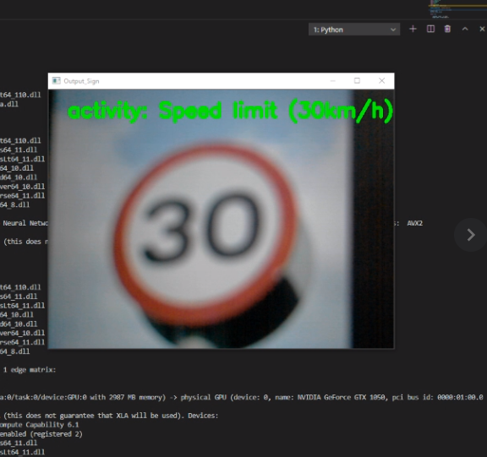
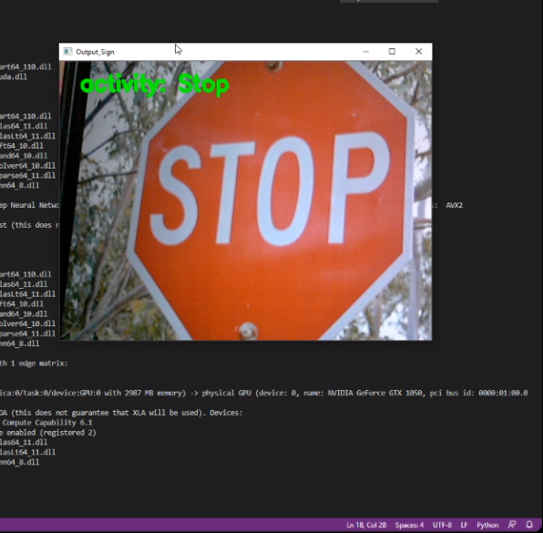
Traffic Sign detection Outputs

Slide 12
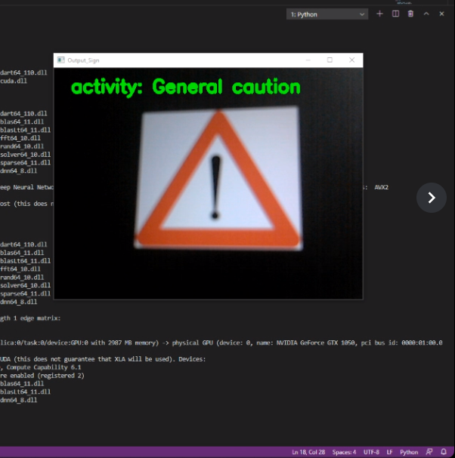
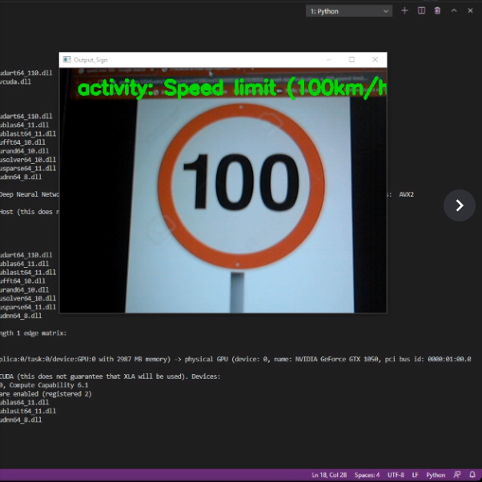
Examples of Traffic sign detection

Slide 13
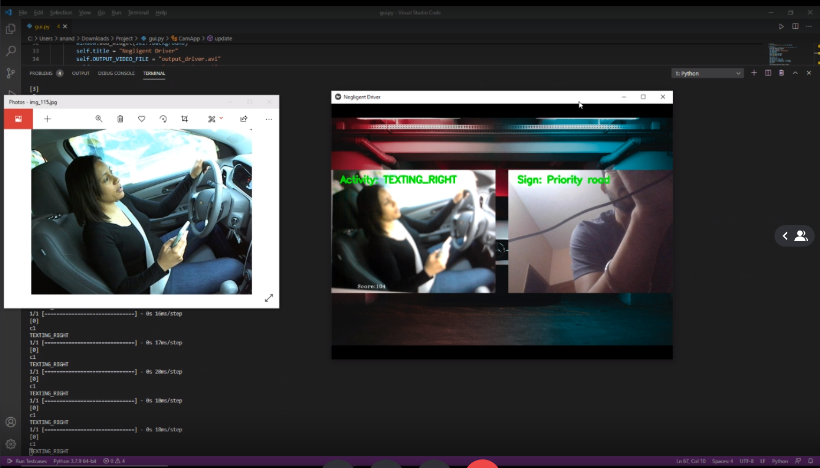
Driver Action TESTING

Slide 14
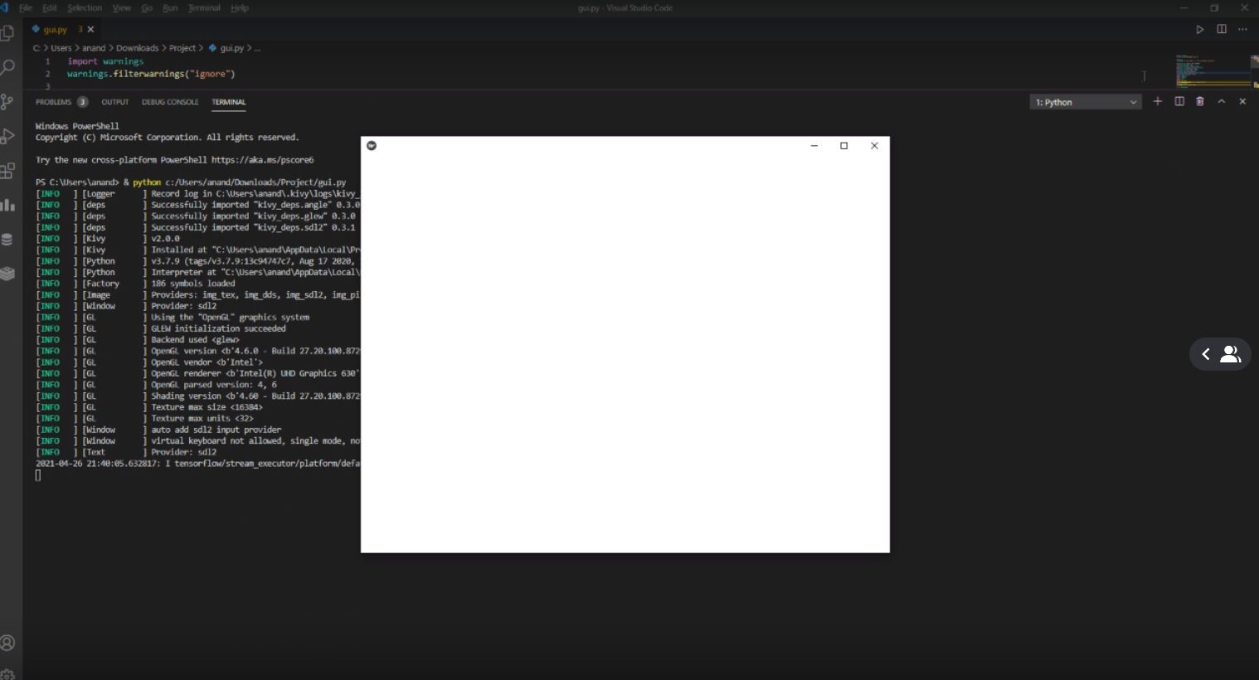
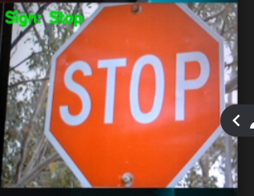
Final GUI WORKING

Slide 15
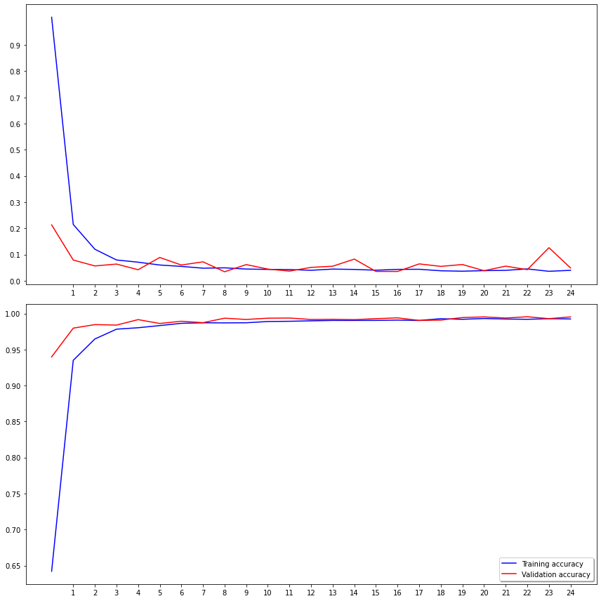
Training Accuracy vs Validation Accuracy

Slide 16
Training Loss vs Validation Loss

Slide 17
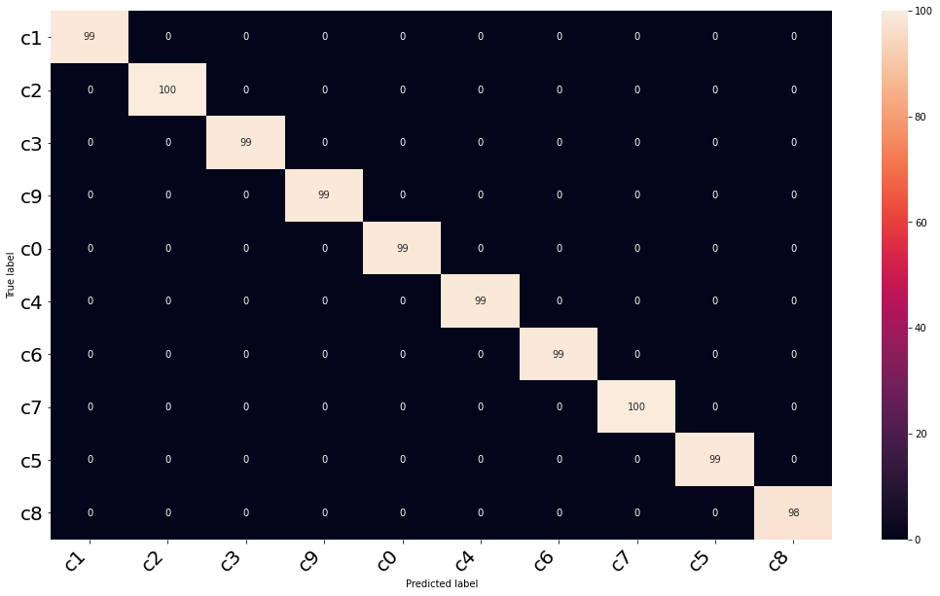
HEATMAP OF DRIVER’S ACTION TESTING DATASET

Slide 18
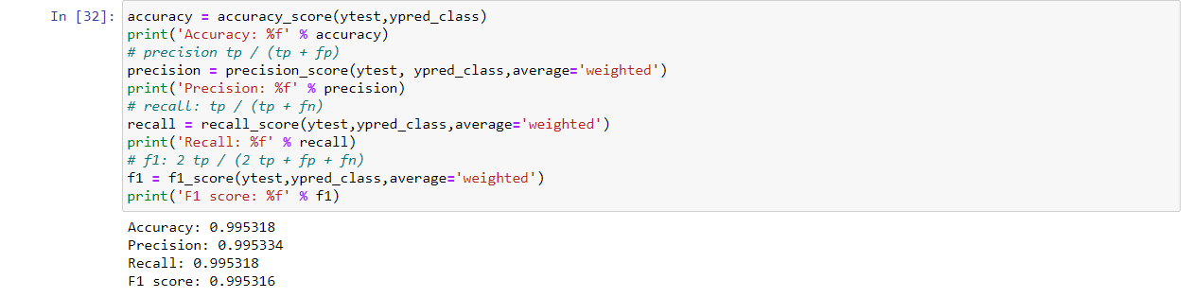
Driver Action Detection Model’s accuracy

Slide 19
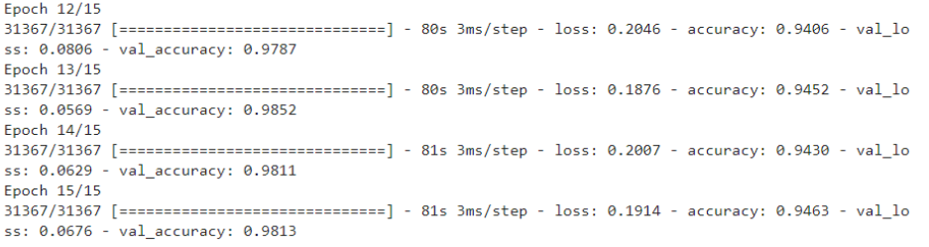
Traffic Sign Detection Model’s accuracy

Slide 20
Conclusion
In automated vehicles and with increasing technology a person is ought to be less concentrated on the driving and while using that technology our model is designed to make a safe journey for everyone.
Classified the driver action detection model with 99% of accuracy
Classified the traffic sign detection model with 95% of accuracy
We need to devise a better face, hands, and skin detector. We would need to manually label hand and face proposals and use them to train a Fast-RCNN (or, any other object detector) to localize both faces and hands in one shot and evaluate it against our existing CNN-based localization method.

Slide 21
Future Scope
Use of object detection and faster CNN for traffic sign detection
To create a software that enables autonomous driving when the driver is distracted for a certain period of time.

Slide 22
References
https://www.kaggle.com/meowmeowmeowmeowmeow/gtsrb-german-traffic-sign
https://keras.io/
https://docs.opencv.org/master/d0/de3/tutorial_py_intro.html
https://analyticsvidhya.com/blog/2017/06/architecture-of-convolutional-neural-networks-simplified-demystified/
https://www.tensorflow.org/tutorials/images/cnn
https://likegeeks.com/kivy-tutorial/
https://neurohive.io/en/popular-networks/vgg16/
https://www.javatpoint.com/pytorch-testing-of-convolutional-neural-network-model
https://www.kaggle.com/c/state-farm-distracted-driver-detection
https://towardsdatascience.com/distracted-driver-detection-using-deep-learning-e893715e02a4
https://www.sciencedirect.com/science/article/abs/pii/S0893608018300054

